Slide 1

Buildtest: HPC Software Stack Testing Framework
Shahzeb Siddiqui (Shahzeb.Siddiqui@3ds.com)
Dassault Systemes
5th Easybuild User Meeting
01/30/2020
GitHub: https://github.com/HPC-buildtest/buildtest-framework
Documentation: http://buildtest.rtfd.io

Slide 2
Motivation
Framework Requirements:
The framework is capable of testing of installed software in HPC Software Stack
The framework is able to integrate with module system
The framework provides users with a markup language for writing tests
The framework is able to automate test creation and execution
The framework provides a test repository that is community driven
Buildtest is not meant to replace tools like make, cmake, or autoconf

Slide 3
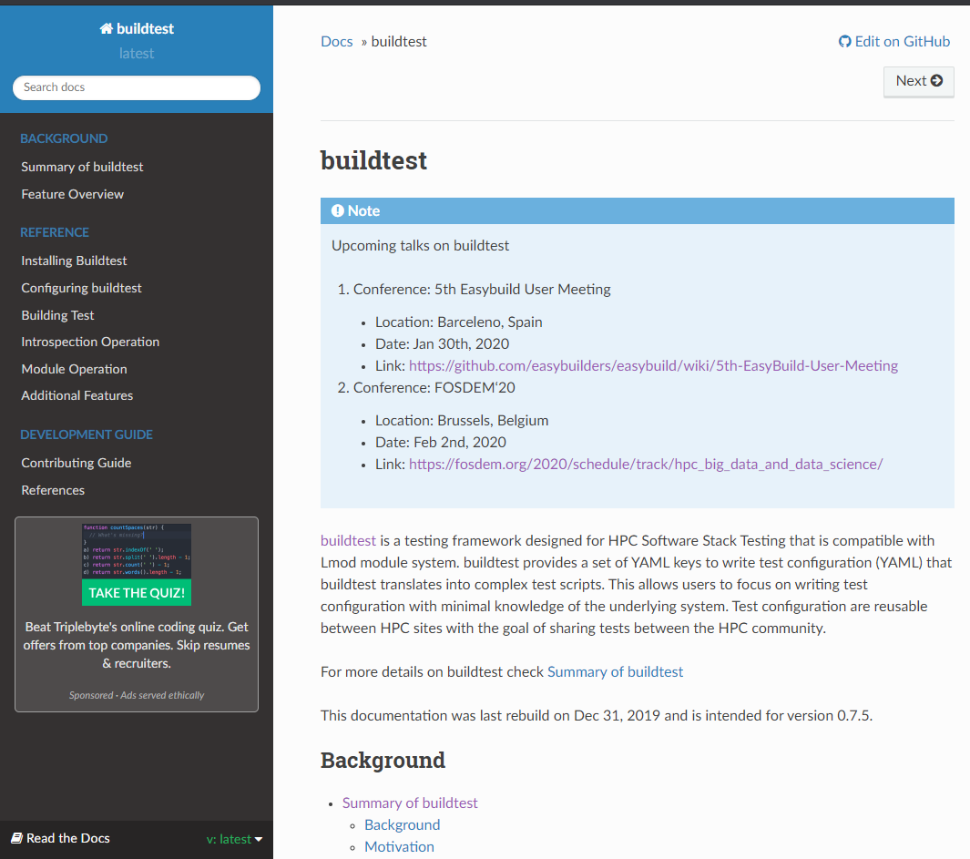
What is buildtest
Buildtest is a framework that:
Automates test script creation
Abstracts test complexity by using test configuration written in YAML
Allows Portable test configurations
Provides many module operations
Buildtest comes with a repository of test configuration and source files

Slide 4
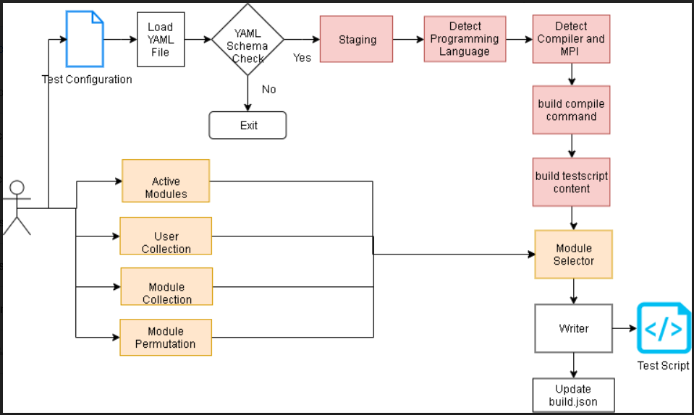
Build Pipeline

Slide 5
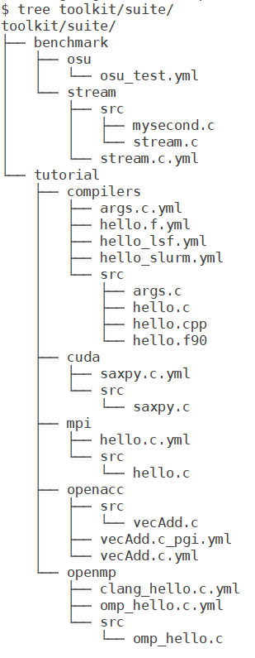
Building a Test
To build a test script just specify a test configuration to buildtest as follows: buildtest build –c <test-configuration>
The test configuration can be found under $BUILDTEST_ROOT/toolkit/suite
Name of test configuration is formulated by replacing file separator (/) by a dot (.) so tutorial/compilers/args.c.yml → tutorial.compilers.args.c.yml
Source code must be under src directory and test configuration must be named with extension .yml

Slide 6
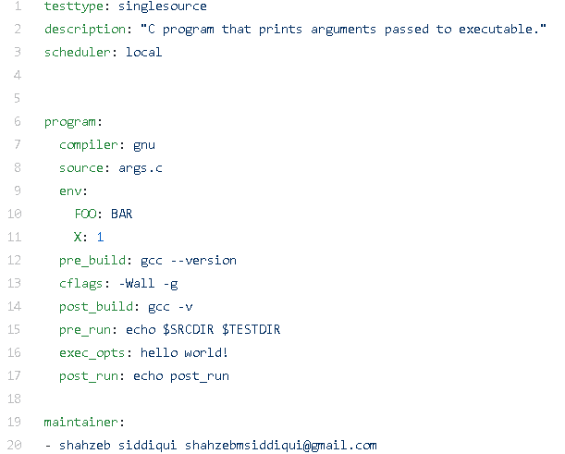
Test Configuration
Informs buildtest this is a Single Source Compilation. Implemented as a Python Class
Description of text. Limited to 80 chars
Run Test Locally
Start of Test Declaration
Specify Compiler Name
Source File to be compiled
Start of Environment Variable Declaration
Commands to run before and after compilation.
Passing flags to C compiler
Commands to run before and after execution.
Passing Arguments to the Executable
List of Maintainers

Slide 7
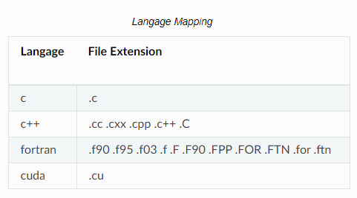
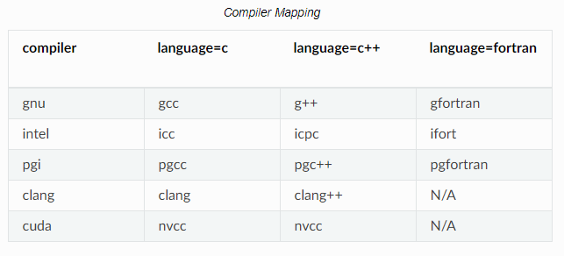
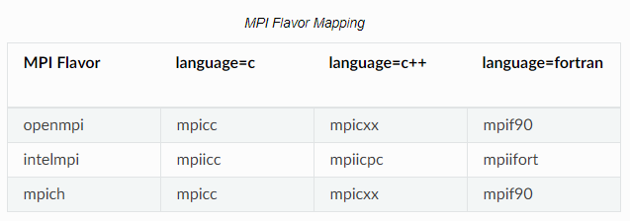
Language, Compiler and MPI Detection

Slide 8
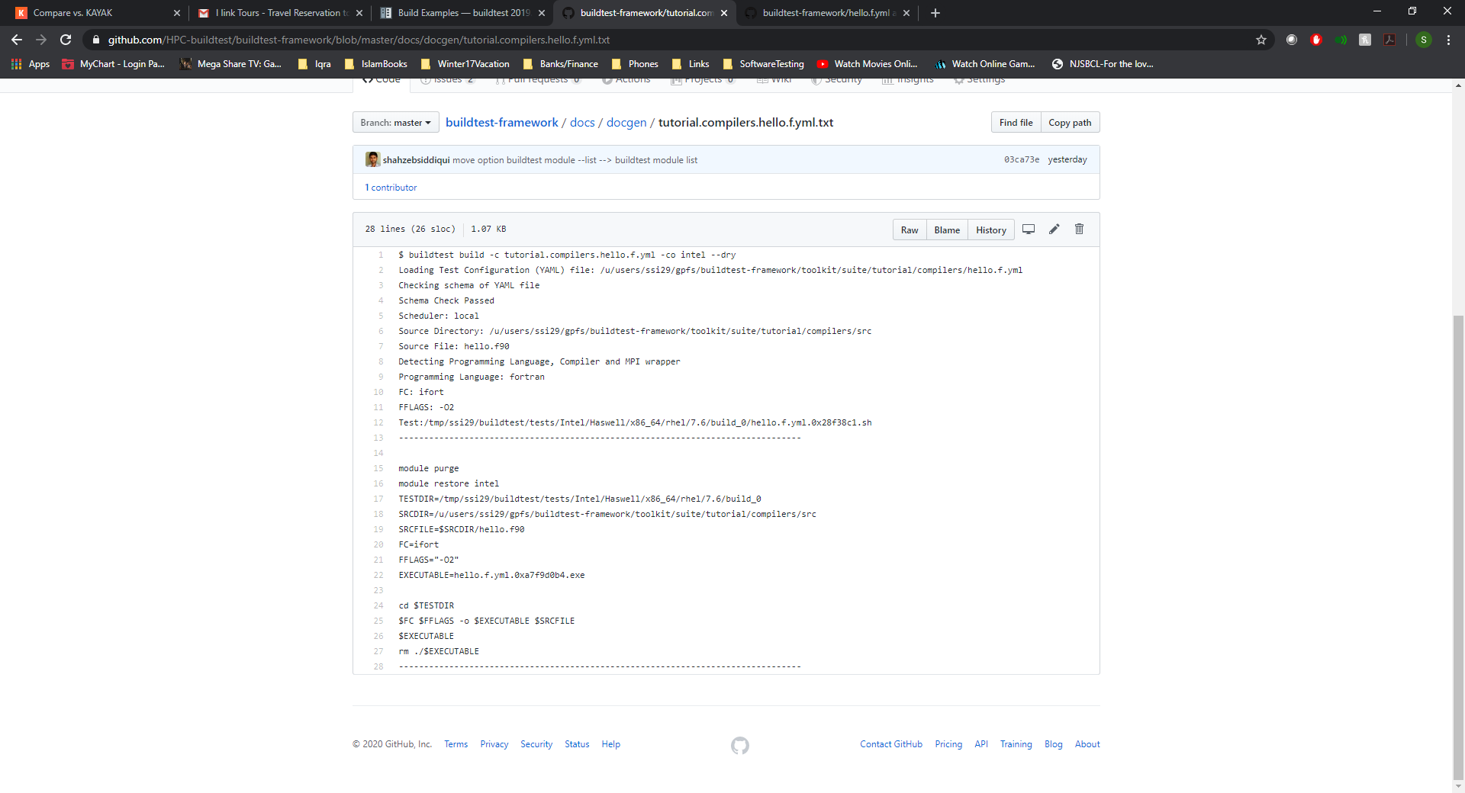
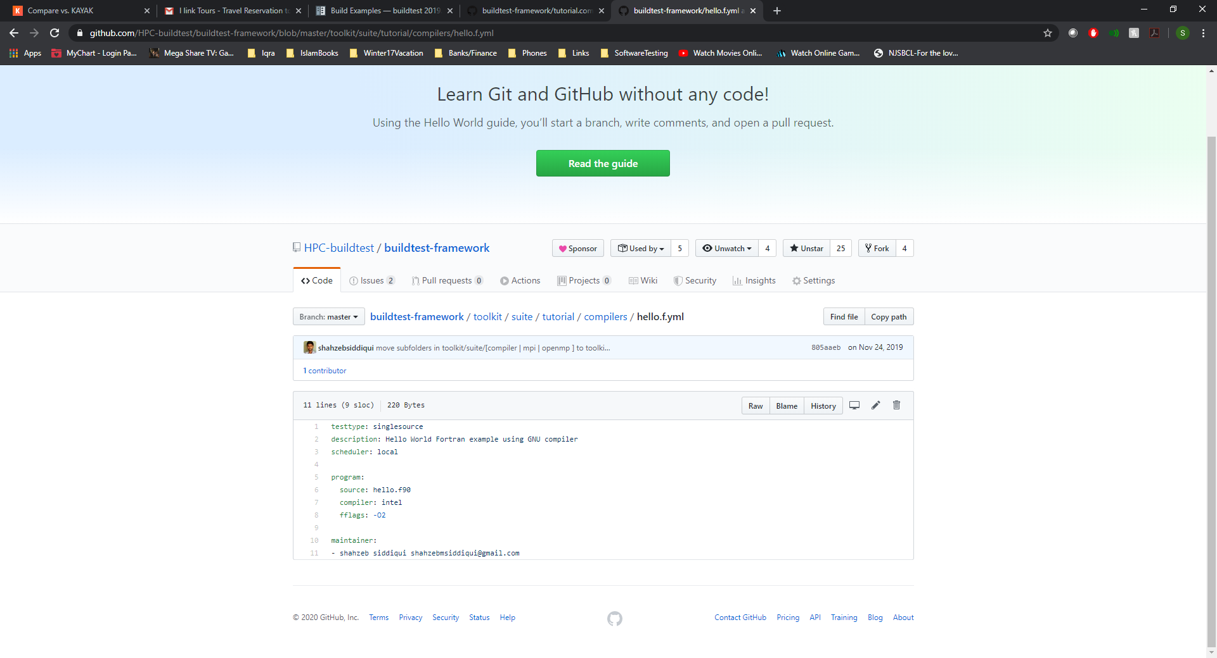
Intel Example

Slide 9
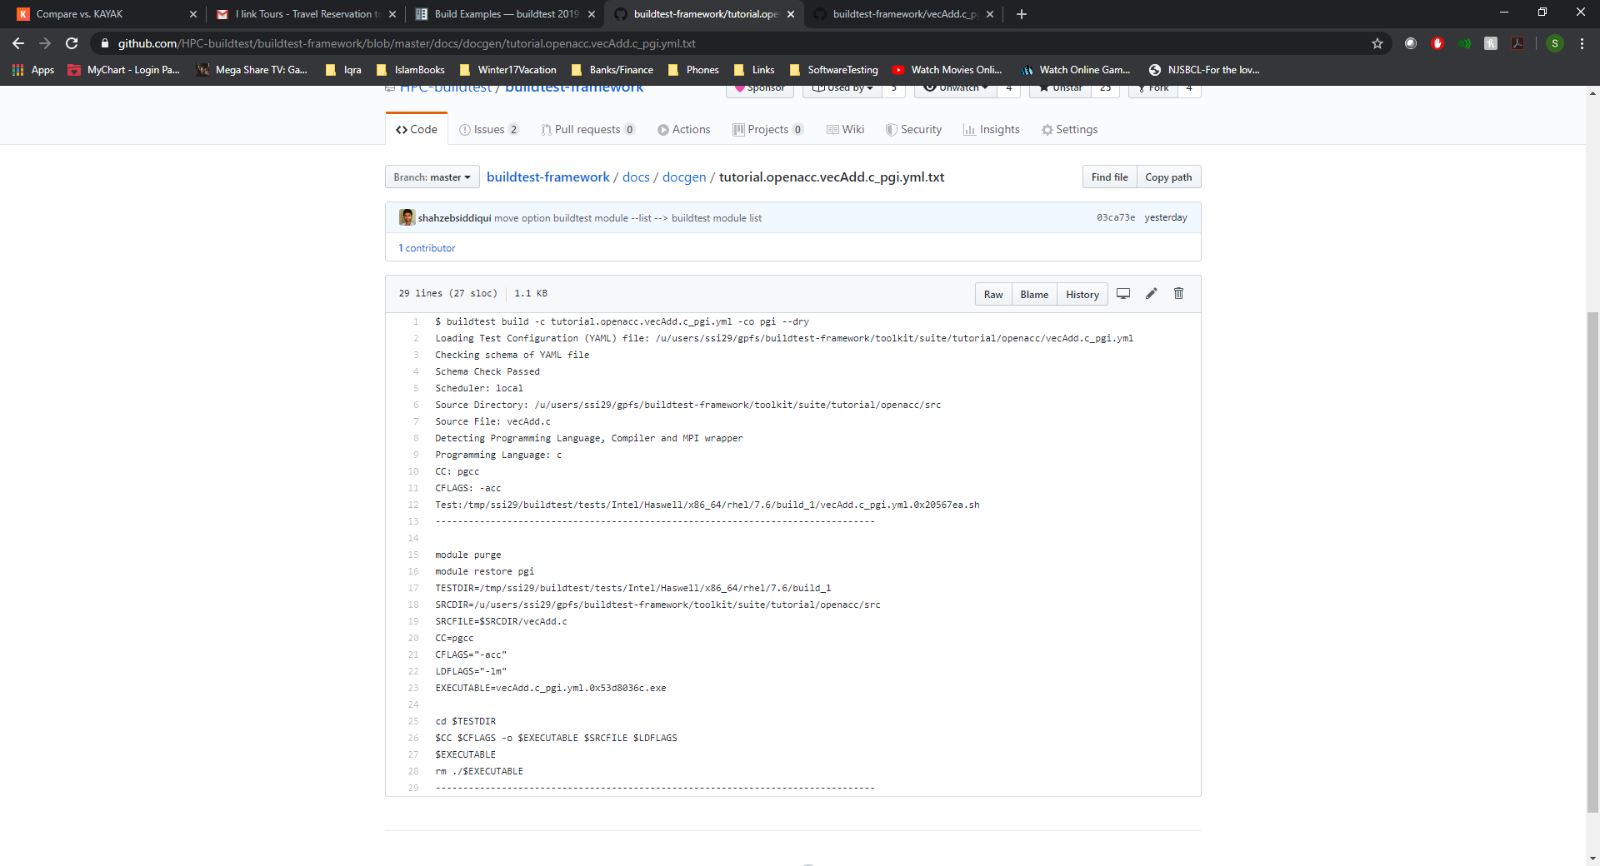
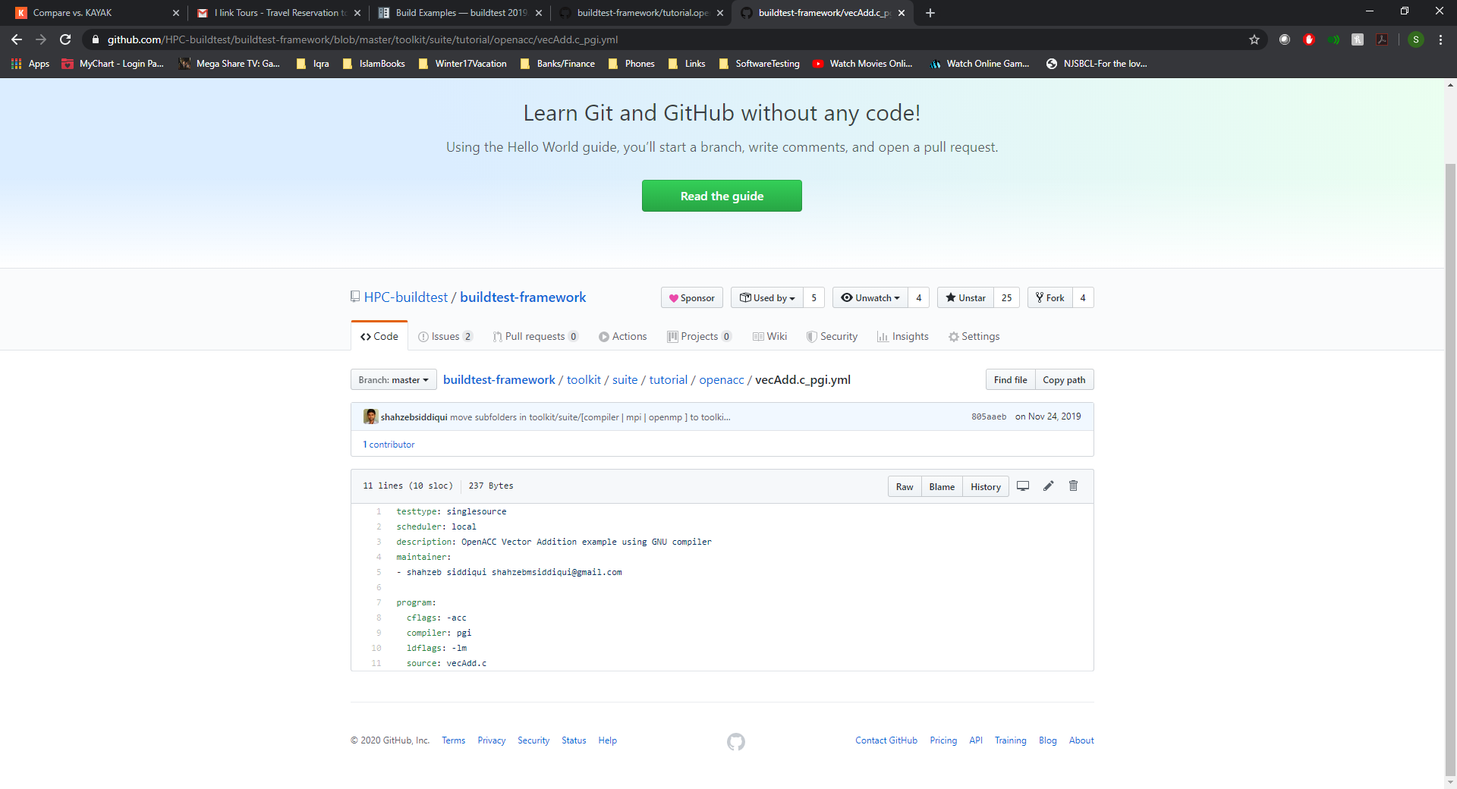
PGI Example
The vecAdd.c program is an OpenACC vector addition program that requires linking to math library (-lm)

Slide 10
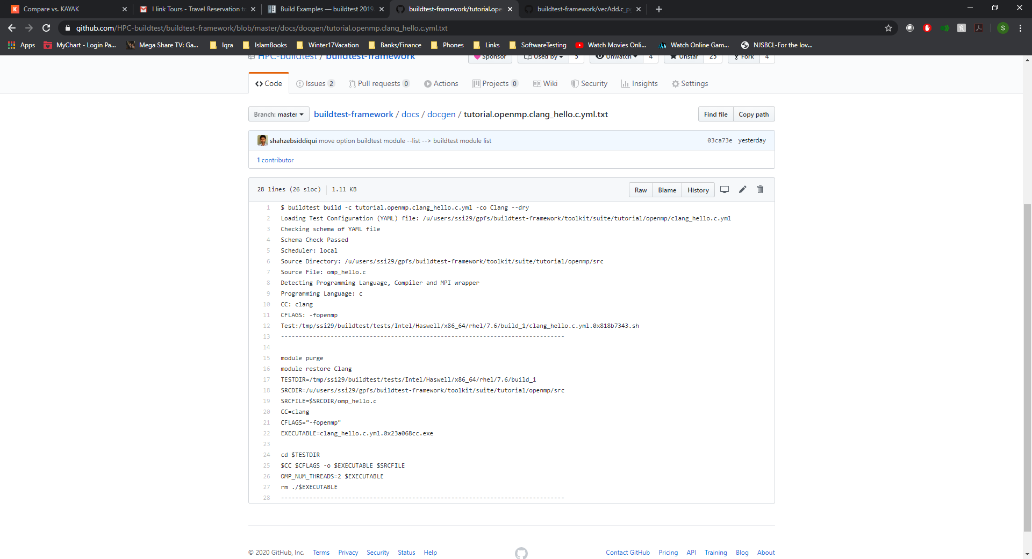
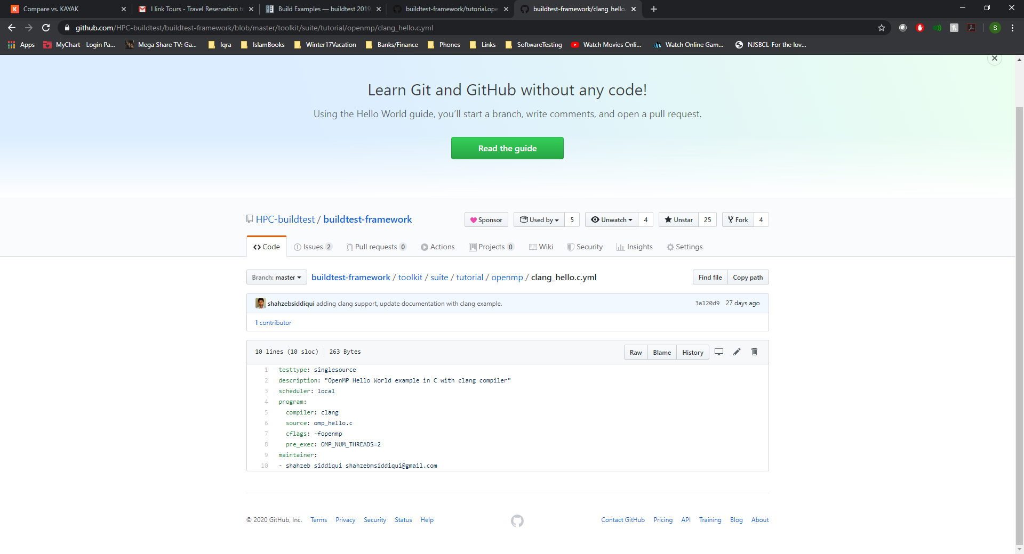
Clang Example

Slide 11
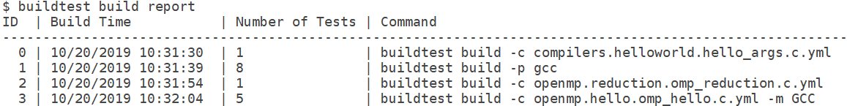
Build History
Buildtest keeps track of every build in a json file (build.json). The build ID that can be used to retrieve tests, logs, and run tests
To retrieve a report of all builds: buildtest build report

Slide 12
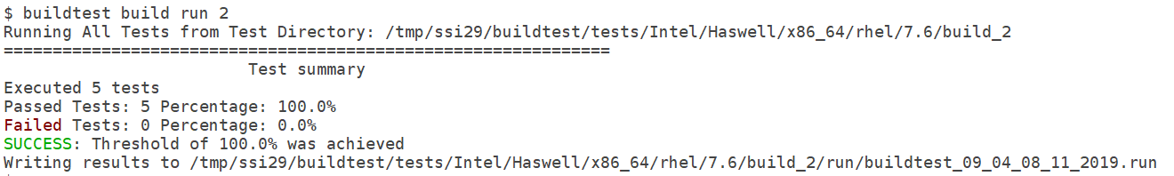
Running Test Locally
Running buildtest build run <ID> will run all test scripts that corresponds to the build ID.
Buildtest will write a .run file that contains output of all tests
A zero exit status will be a PASSED test and non-zero will be a FAILED test

Slide 13
Integration with Spider
Buildtest solves the module load problem by parsing json content by executing: spider –o spider-json $BUILDTEST_MODULEPATH
Buildtest leverages spider to load modules into test.
Spider is automatically updated when MODULEPATH changes!
For more details on spider refer to the documentation: https://lmod.readthedocs.io/en/latest/136_spider.html

Slide 14
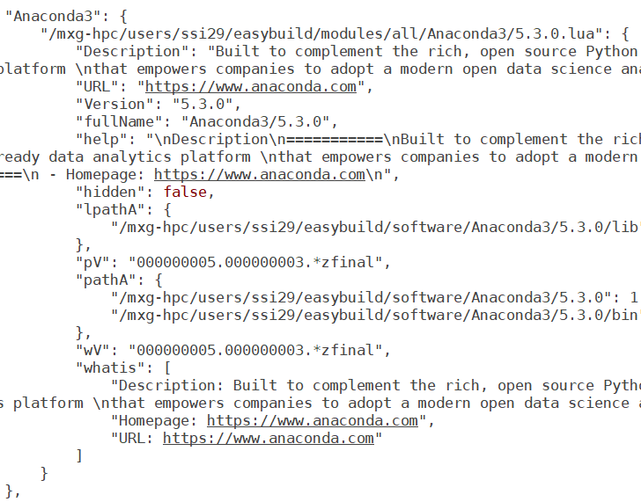
Spider Content

Slide 15
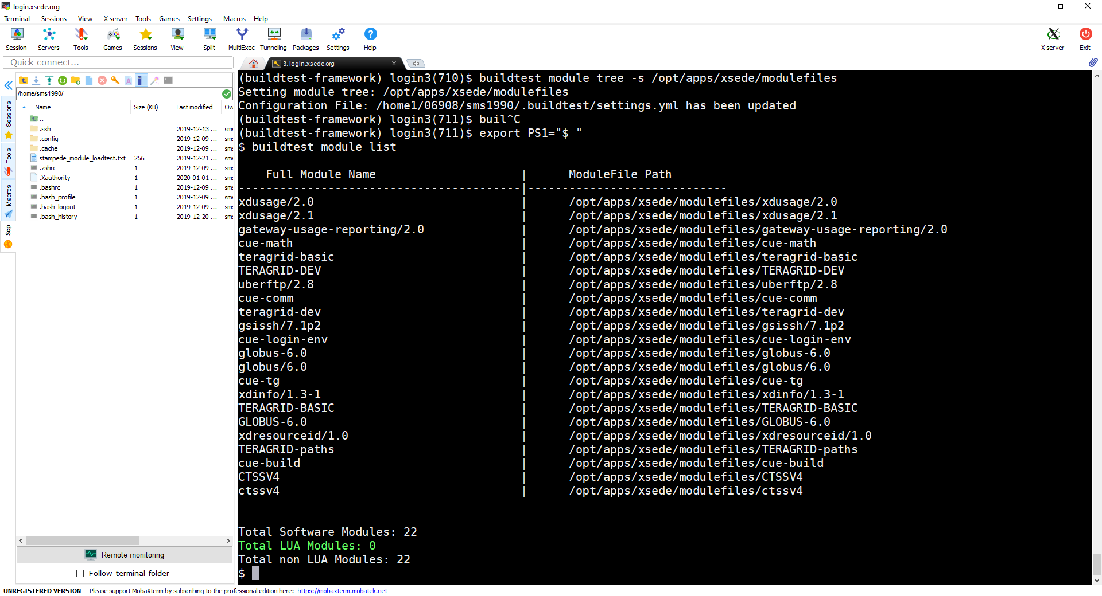
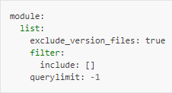
Reporting Modules
Buildtest will retrieve spider record from Lmod and present full canonical module name and path to module file.
Buildtest will retrieve modules from all trees defined by BUILDTEST_MODULEPATH
The default configuration for buildtest module list is defined as follows:
exclude_version_files: true will ignore .version, .modulerc, and .modulerc.lua
querylimit: -1 Controls number of entries to print. A negative or 0 will print all entries
include: [] filter output by list of module full canonical name

Slide 16
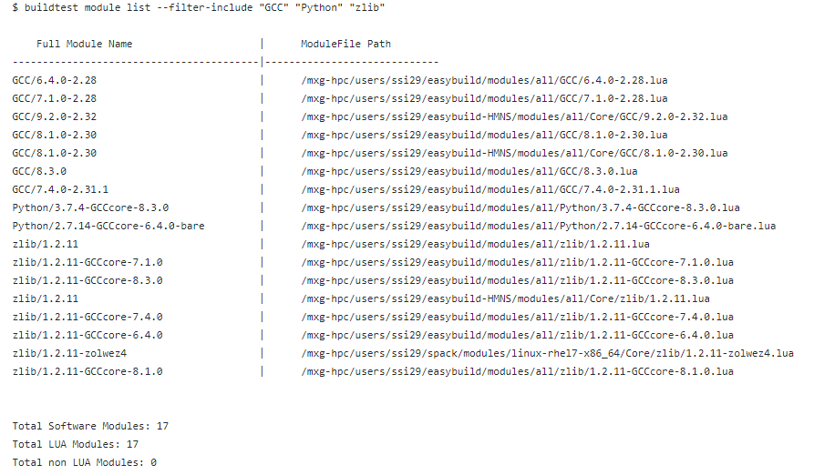
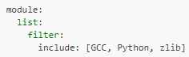
Reporting Filtered Modules
In order to filter modules GCC, Python, zlib. You can specify this in buildtest configuration (settings.yml) or via command line option -–filter-include

Slide 17
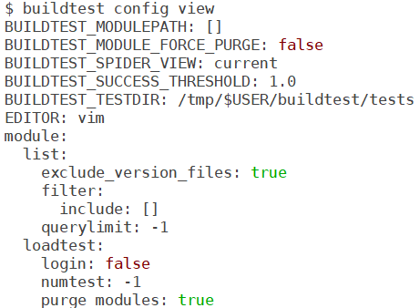
Buildtest Setting
Buildtest configuration file is stored in $HOME/.buildtest/settings.yml
The configuration is automatically placed if not found or deleted accidently.
To view or edit the configuration file you can run: buildtest config view or buildtest config edit
To learn more see how to Configure buildtest at https://buildtest.readthedocs.io/en/latest/configuring_buildtest.html

Slide 18
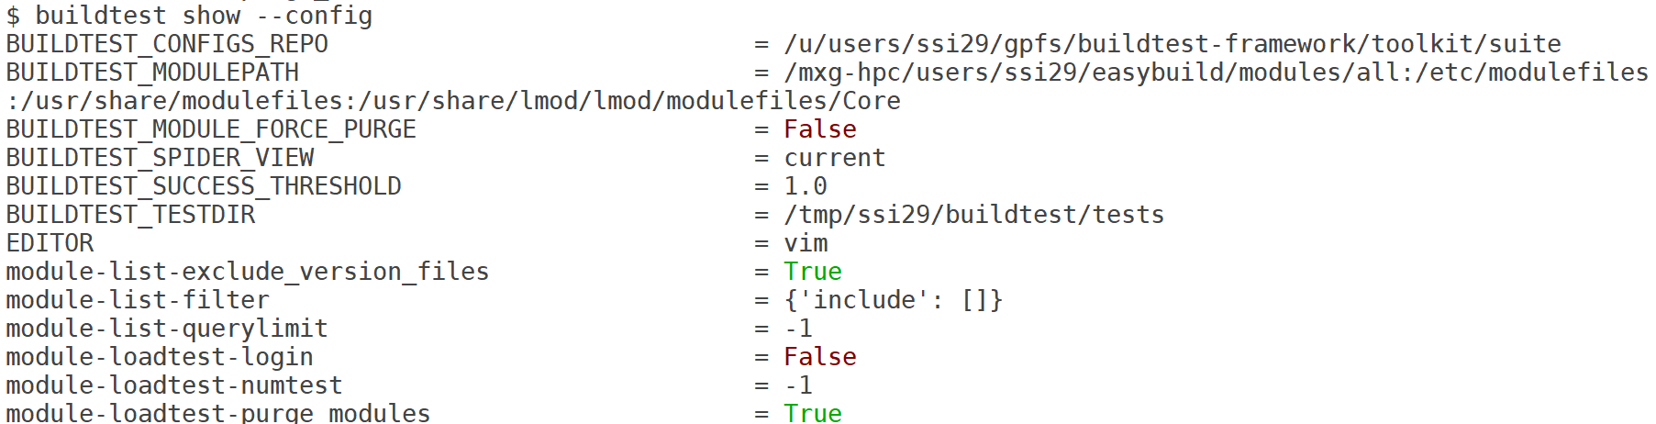
Buildtest Setting
buildtest can report the configuration settings by running buildtest show –config

Slide 19
Stampede2 Use Case (1/3)
Use Case: User wants to find all modules built for intel/18.
1. User can set root of module tree which will update BUILDTEST_MODULEPATH.
2. User can view list of module trees

Slide 20
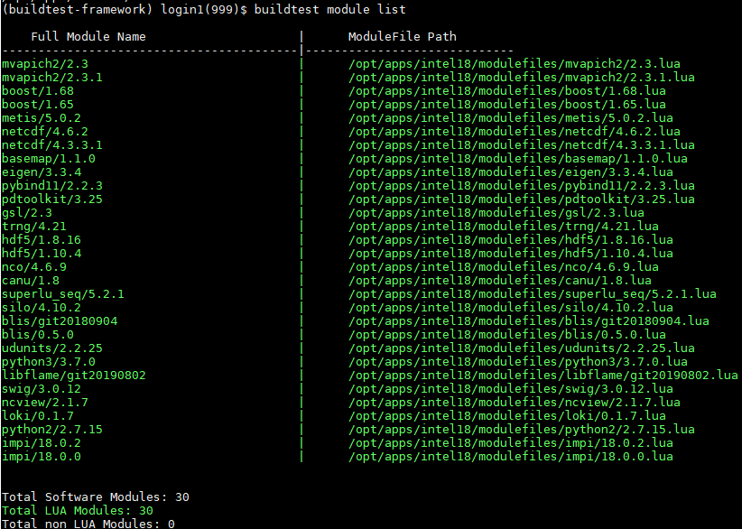
Stampede2 Use Case (2/3)
Same output you would see when running module av
Buildtest will report all modules in tree /opt/apps/intel/18/modulefiles

Slide 21
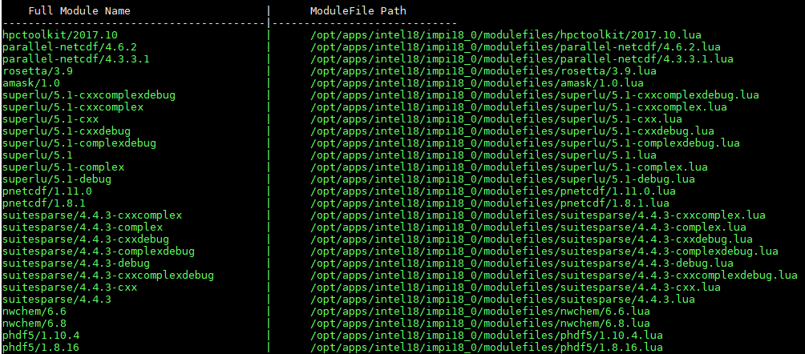
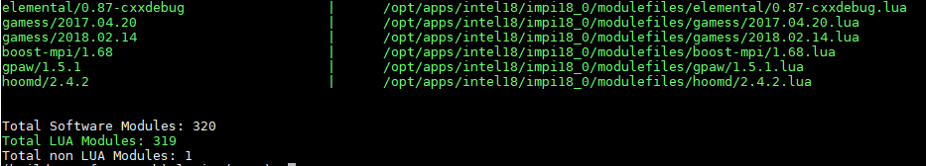
Stampede2 Use Case (3/3)
Previously we saw 30 modules, in /opt/app/intel18/modulefiles but there are 320 modules when counting all subtrees.
Lua and non-lua modules are color coded which can help spot modules quickly

Slide 22
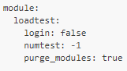
Module Load Testing (1/3)
Buildtest can automate module load test for a module tree specified in BUILDTEST_MODULEPATH.
Since v0.7.5, buildtest provides a few configuration options to control behavior of module loadtest. The following configuration can be found in settings.yml
By default, buildtest will run test in sub-shell but you can run them in login shell if login: true
Buildtest will purge modules before loading modules, this is controlled by purge_modules: true
User can control how many tests to run before terminating by using numtest. A negative or zero will run all tests

Slide 23
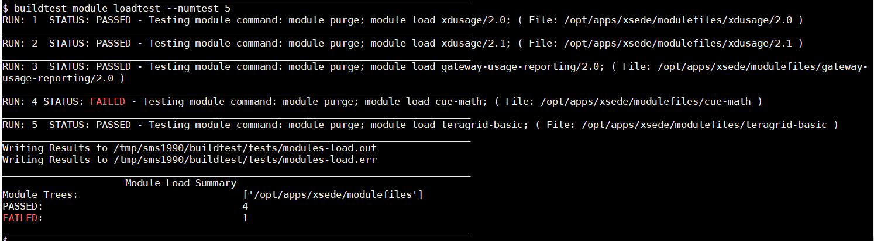
Module Load Testing (2/3)
Command Executed

Slide 24
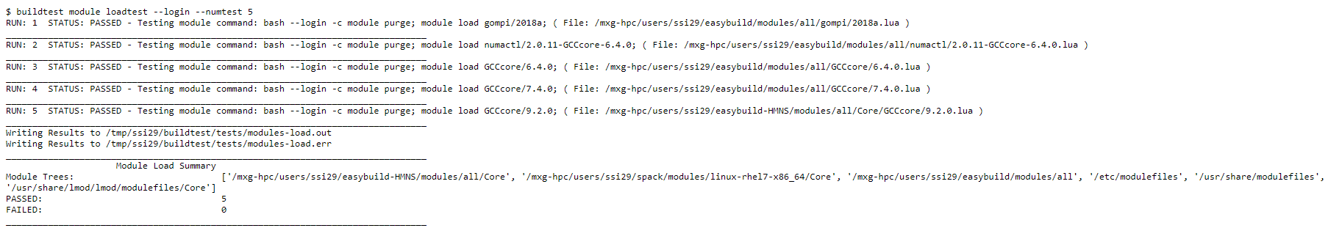
Module Load Testing (3/3)
Command Executed
Module File Tested

Slide 25
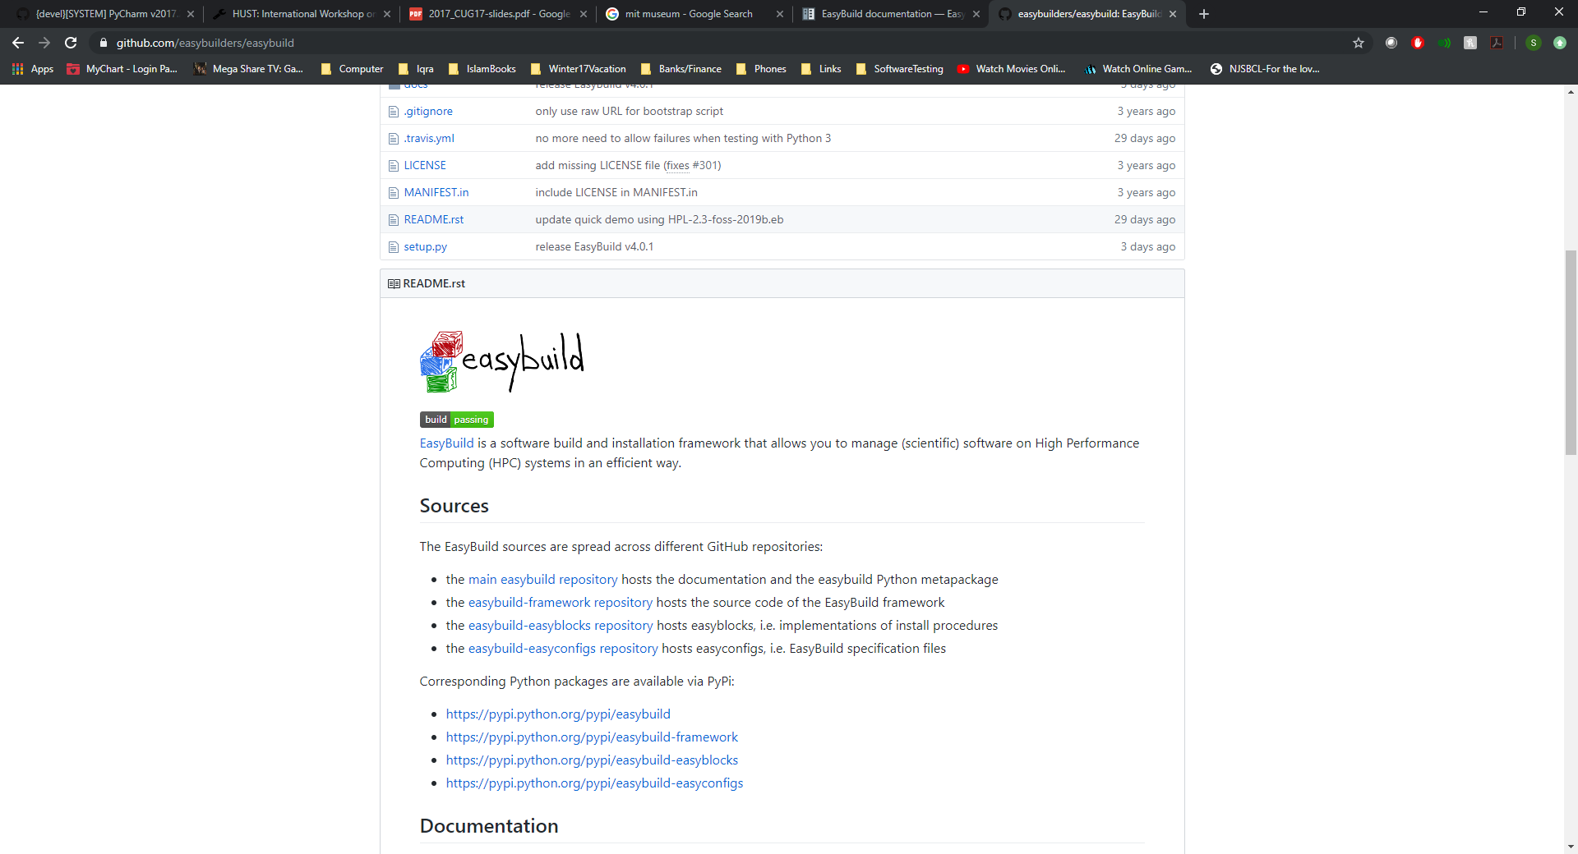
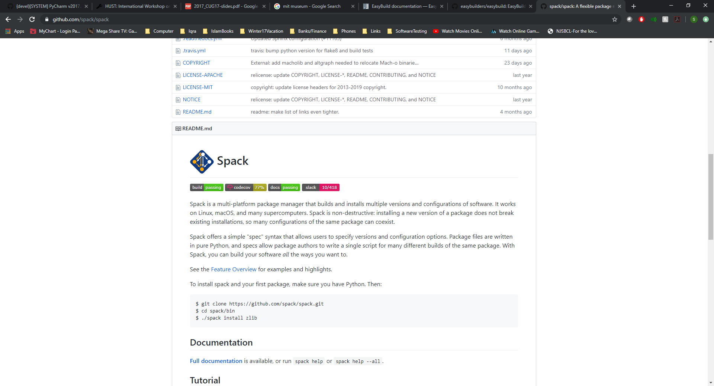
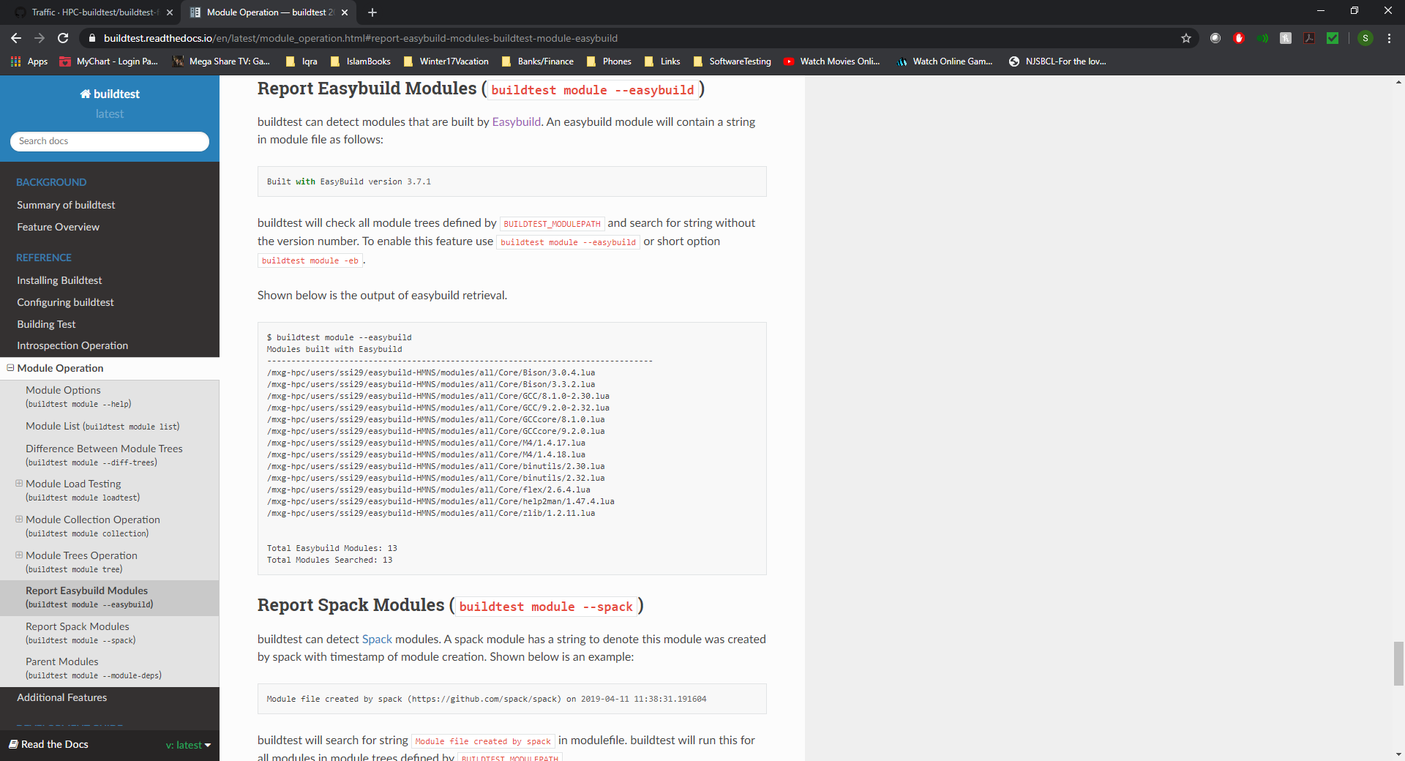
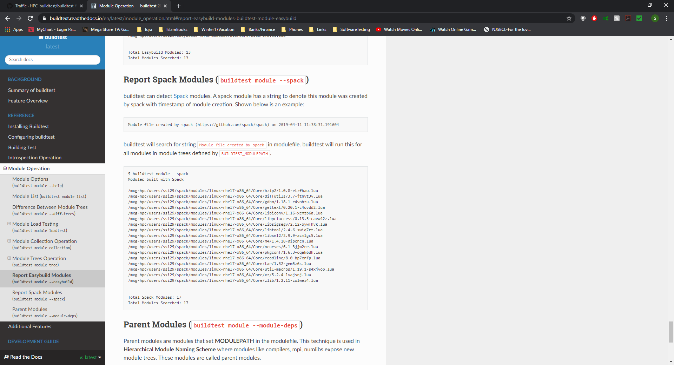
Reporting EasyBuild and Spack Modules

Slide 26
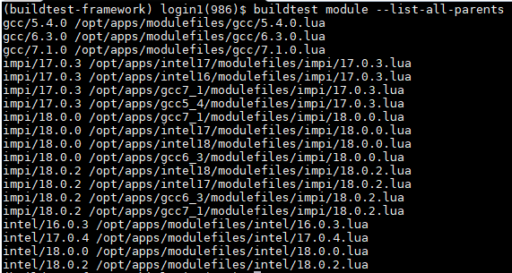
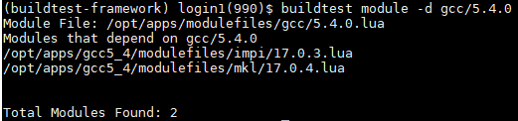
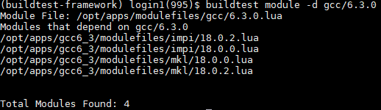
Retrieving Parent Modules
Users and administrators can quickly find all parent modules (modules that set MODULEPATH) with buildtest module –-list-all-parents.
At Stampede2 with up to 900+ modules users can find all parent modules and see all child modules from a given parent using buildtest module –d <parent-module>

Slide 27
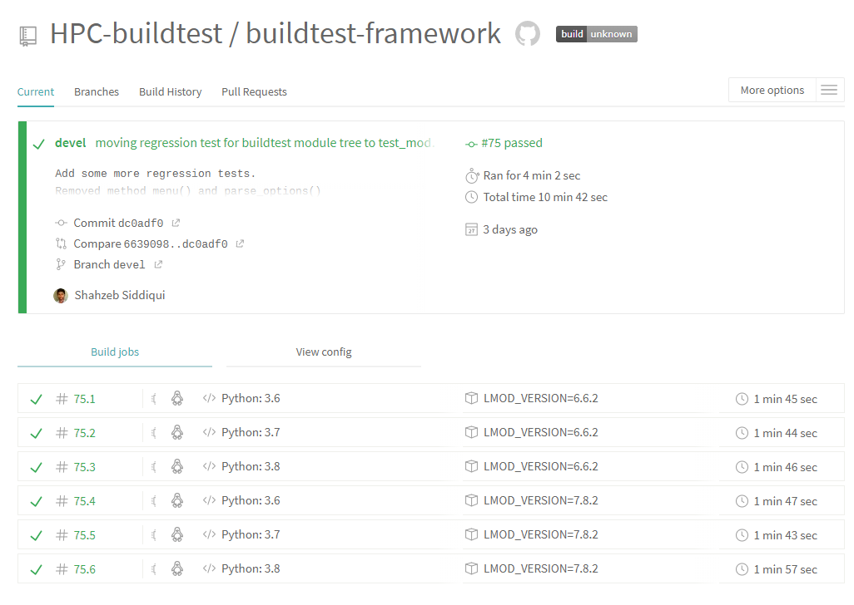
Travis
Since v0.7.4, buildtest can run its regression test in Travis. Several improvement to Travis configuration in v0.7.5
Currently, buildtest contains approximately 30+ regression tests
Some regression tests rely on having a software stack, so buildtest builds a mini stack using easybuild.
Buildtest is tested for Python 3.6, 3.7, 3.8 and Lmod version 6.6.2 and 7.8.2

Slide 28
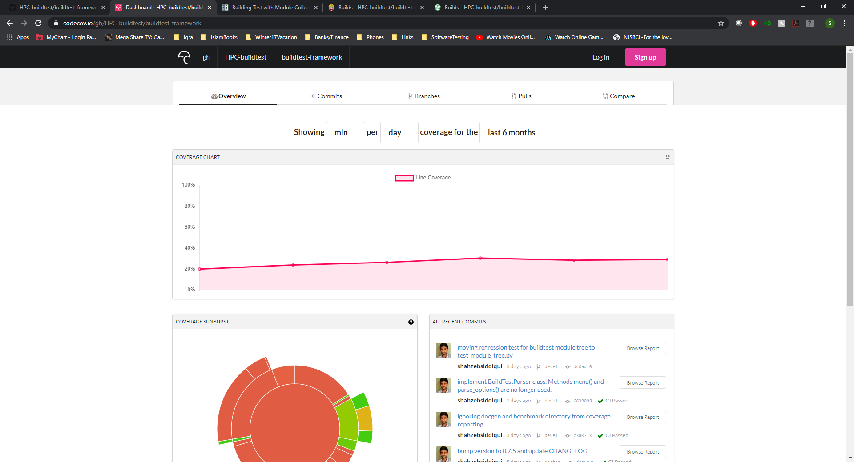
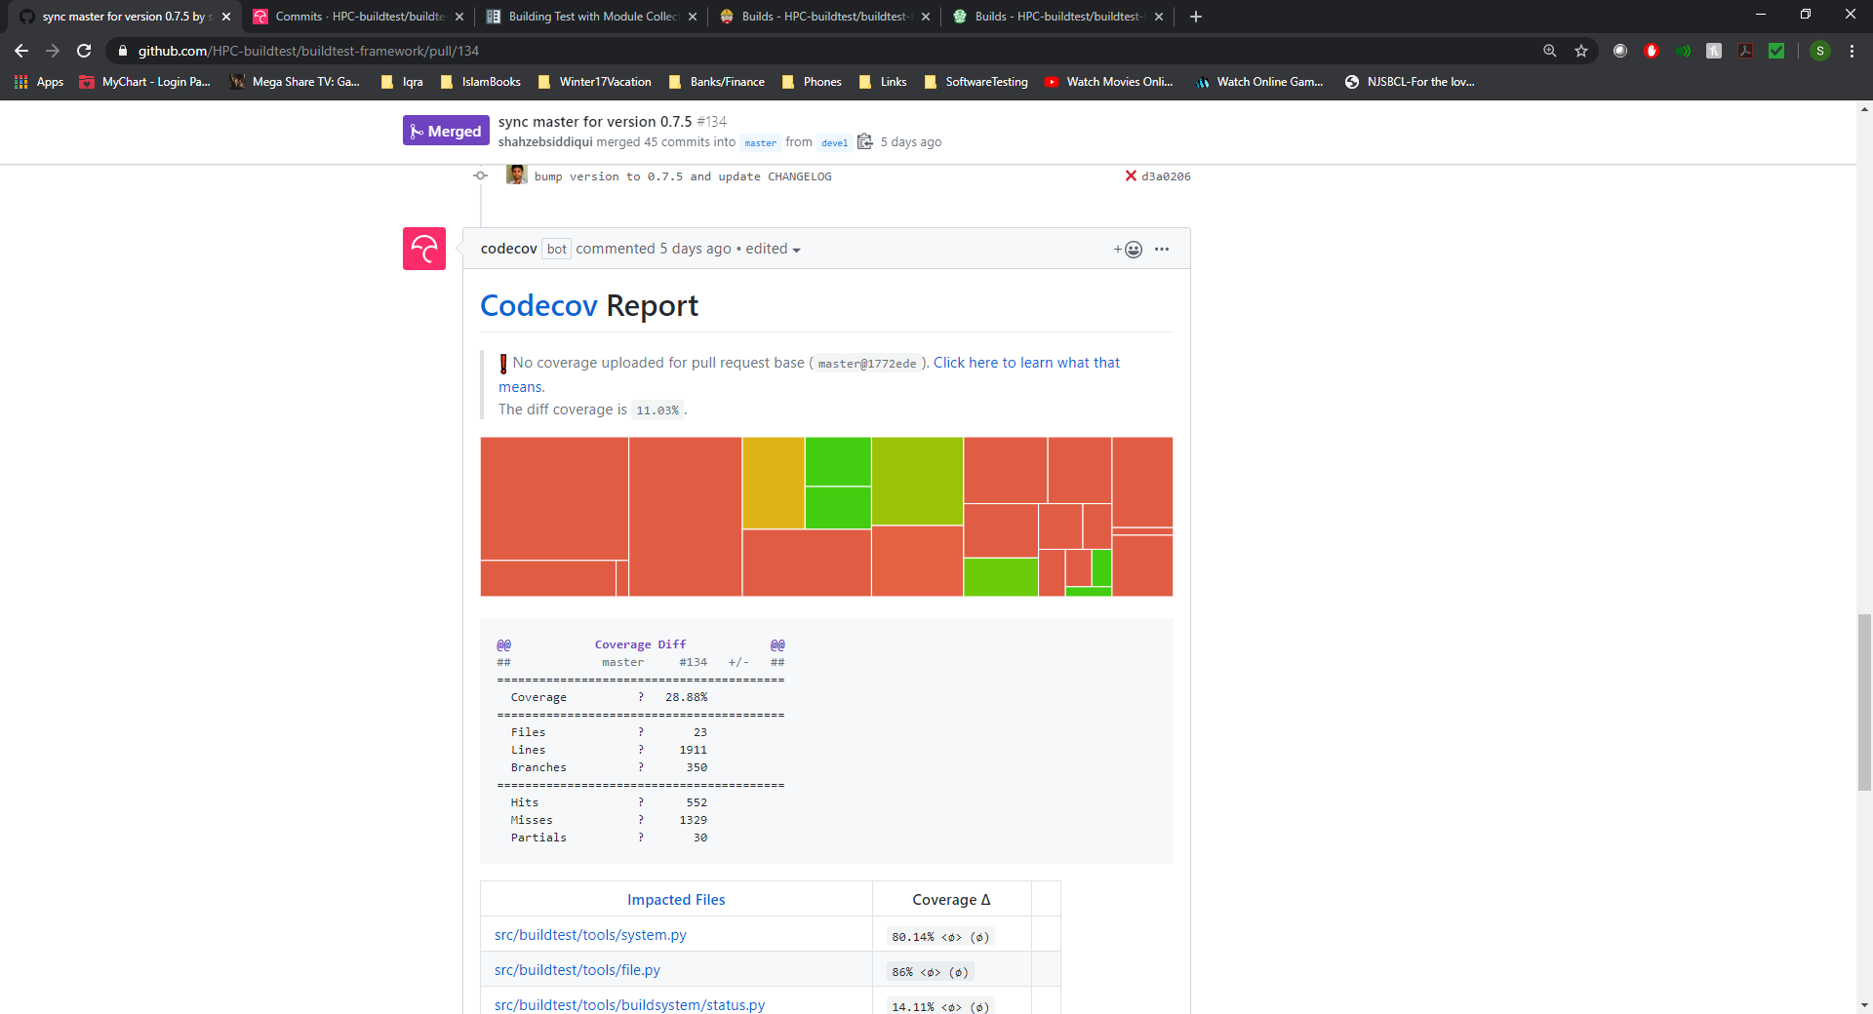
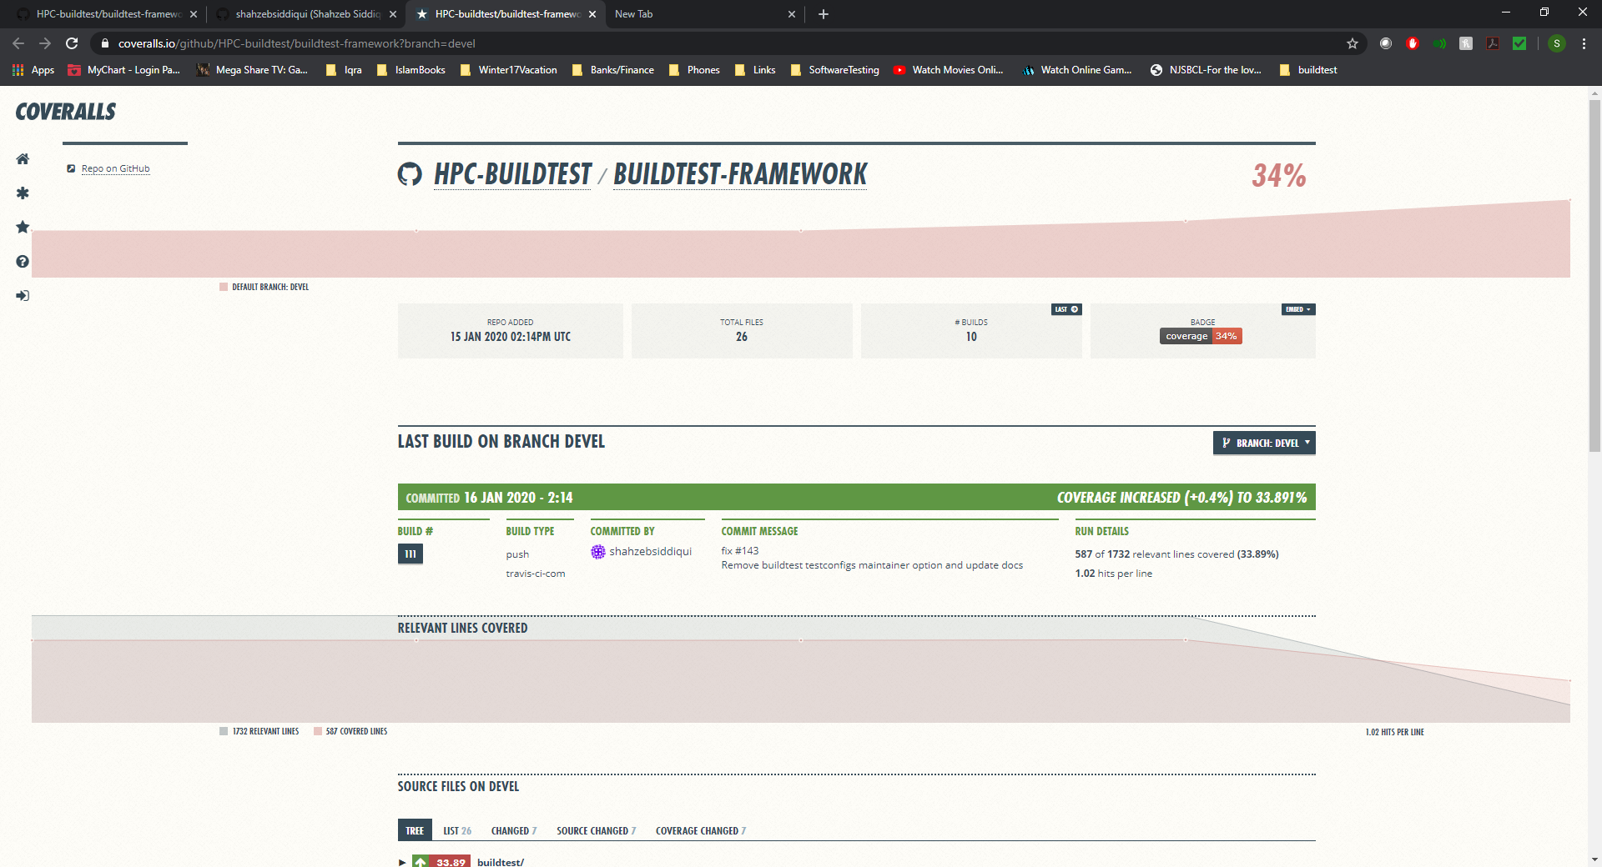
Coverage Report
Since v0.7.5, buildtest can capture coverage report via codecov that is found at https://codecov.io/gh/HPC-buildtest/buildtest-framework
Coverage report is automatically reported by codecov bot on pull requests
Coveralls provides in-depth and more user-friendly coverage report like codecov

Slide 29
Current Challenges
Travis Build Timeouts if job takes more than 50mins. Buildtest requires a software stack to run some of its regression tests
Currently, buildtest installs easybuild and lets eb installs 2-3 software to get software stack to test some module functionality
One approach is to build easybuild containers via singularity and pull images in Travis build and rewrite some regression test to test against containers

Slide 30
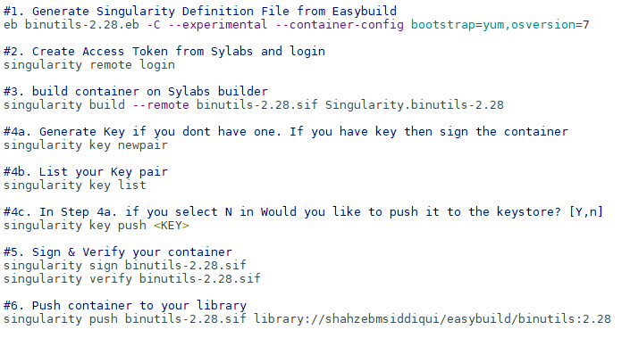
Easybuild Singularity Container Workflow
GitHub: https://github.com/HPC-buildtest/buildtest-framework Documentation: http://buildtest.rtfd.io

Slide 31
GitHub Integration
GitHub Apps Integration
CI: Travis
Code Quality: CodeCov, Coveralls, CodeFactor
Security: Snyk, GuardRails
GitHub Bot Integration
Issue-Label Bot (https://github.com/marketplace/issue-label-bot)
Stale (https://github.com/marketplace/stale)
Trafico (https://github.com/marketplace/trafico-pull-request-labeler)
Pull-Request-Size (https://github.com/marketplace/pull-request-size)
GitHub Action Integration
Black Code Formatter (https://github.com/marketplace/actions/black-code-formatter)
URLs-checker (https://github.com/marketplace/actions/urls-checker)

Slide 32
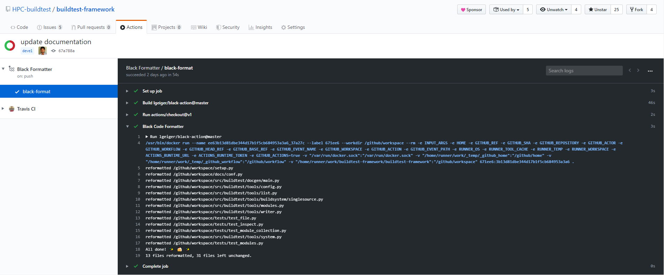
Autoformat Python Code with Black
Buildtest codebase is automatically formatted upon push and pull request using GitHub Workflow Action Black Code Formatter (https://github.com/marketplace/actions/black-code-formatter)

Slide 33
Future Work
Current YAML schema has some limitation that do not address the following
Declaring variables in tests
Test permutation (compilation flags, multiple runs, environment variables, compilers)
Running test with a range of values (i.e running OpenMP program with range of threads OMP_NUM_THREADS=[1-40] )
Support for multiple source compilation
Merge building and execution of test into one operation. Currently the two operations are separated
Increase coverage report for regression tests

Slide 34
Reference
Slack Channel | https://hpcbuildtest.slack.com/
Join Slack via Heroku | https://hpcbuildtest.herokuapp.com/
Documentation | http://buildtest.readthedocs.io/
GitHub | https://github.com/HPC-buildtest/buildtest-framework
ReadTheDocs | https://readthedocs.org/projects/buildtest/
Codecov | https://codecov.io/gh/HPC-buildtest/buildtest-framework
Travis | https://travis-ci.com/HPC-buildtest/buildtest-framework
Coverall | https://coveralls.io/github/HPC-buildtest/buildtest-framework
CodeFactor | https://www.codefactor.io/repository/github/hpc-buildtest/buildtest-framework
Snyk | https://app.snyk.io/org/hpc-buildtest/
GuardRails | https://dashboard.guardrails.io/default/gh/HPC-buildtest

